Slide 1


Apple Maps
Product Evaluation
Harshada Bhide-Apte
Alexander Chao
Gregory Costedoat
Graciela Medrano

Slide 2
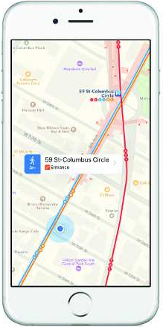
Product Description
IOS application
Purpose: Allows users to find directions, navigate, and view their location on a map
Contains useful data like traffic information to help users accomplish their goals efficiently

Slide 3



Personas
George
Novice User
Uses public transportation
Elroy
Intermediate User
Drives his own vehicle
Elizabeth
Advanced User
Drives her own vehicle
Core Questions
1. Can users look at the map and easily determine where they are going and their orientation?
2. Do users understand the functionalities of the icons contained within the application?

Slide 4
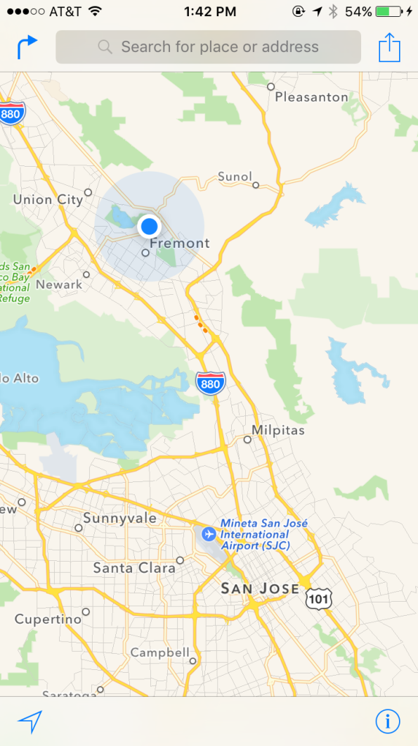
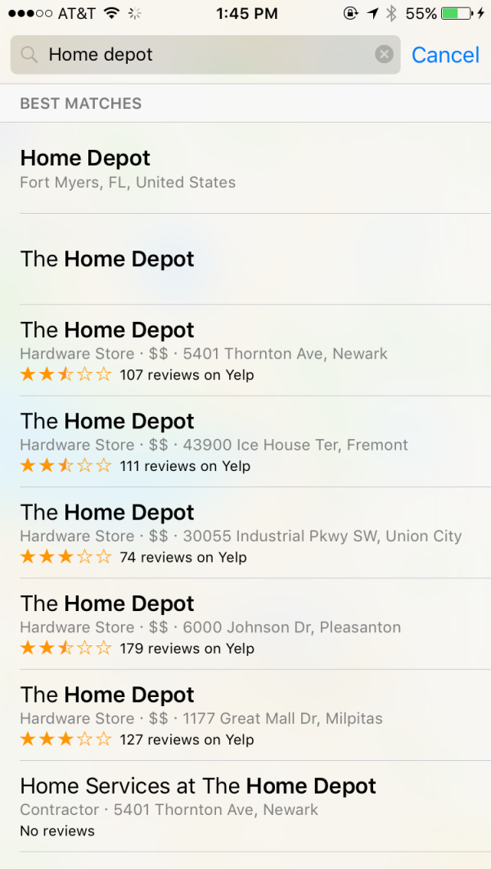
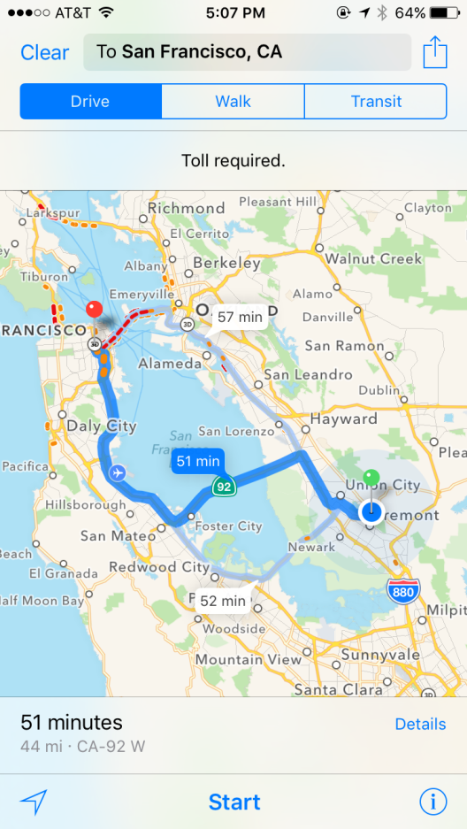
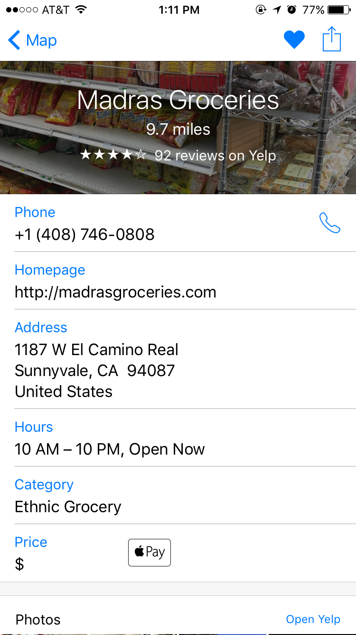
Main Tasks
1. Inputting a search
2. Gathering time estimates
3. Adding Favorites

Slide 5
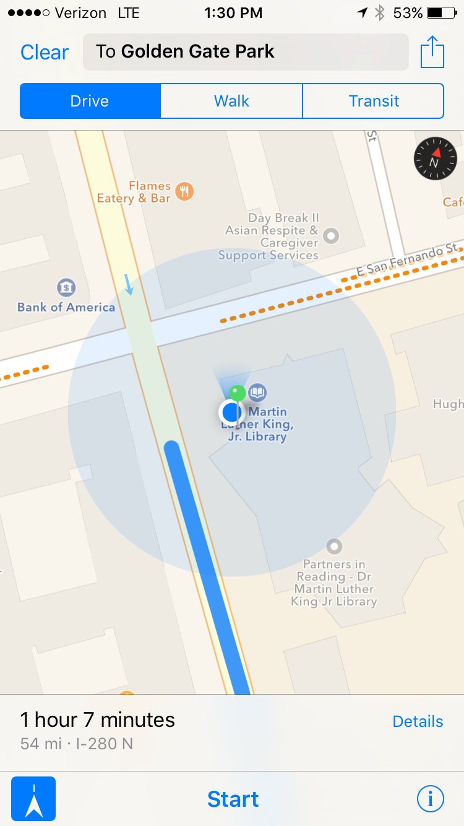
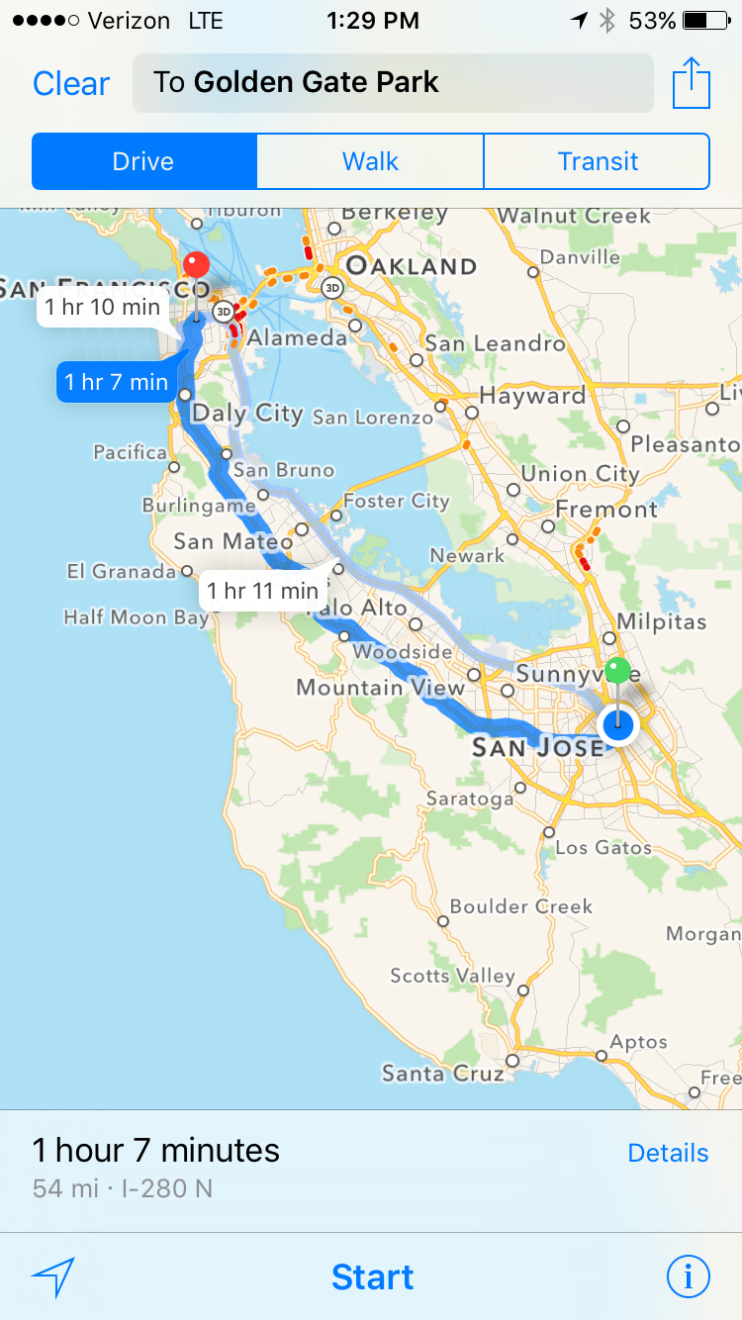
Main Tasks
4. Orienting the user
5. Magnification

Slide 6
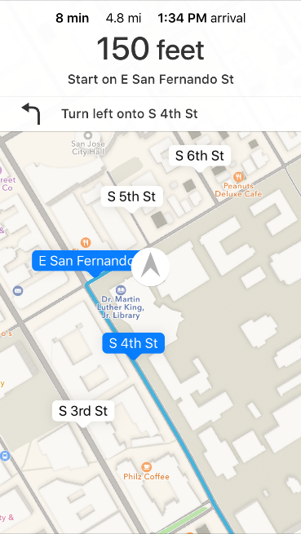
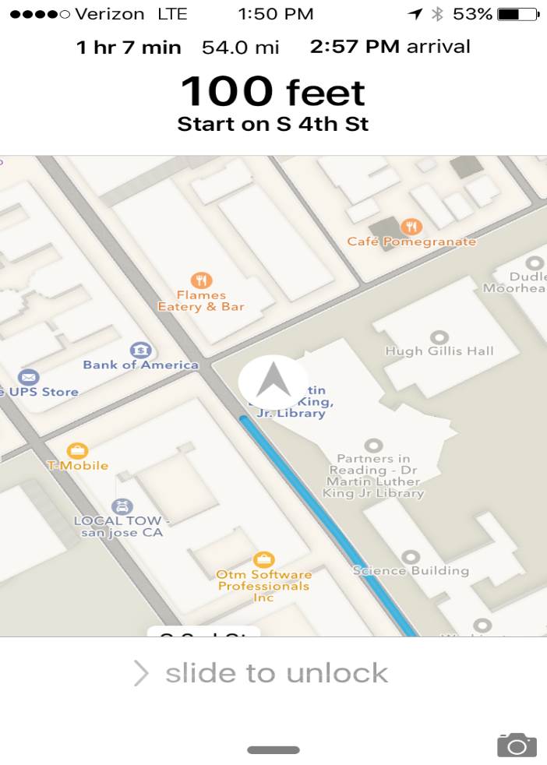
Good Qualities
Compass Icon
Map visible on locked screen
3. Visually appealing navigation

Slide 7
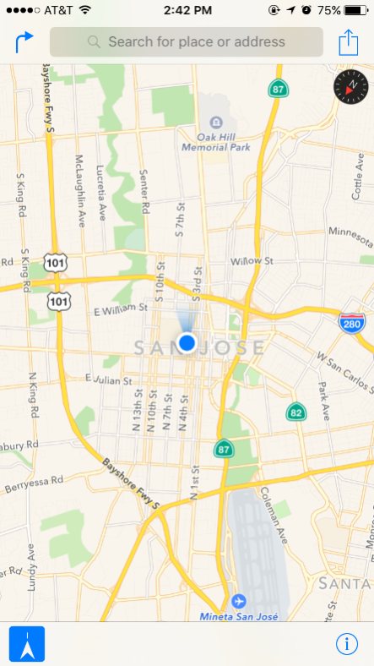
Bad Qualities
1. Pin drop - lack of perceived affordance
2. Self-Orientation
Flashlight
One click current location
Not intuitive
Design should have been easily recognizable

Slide 8
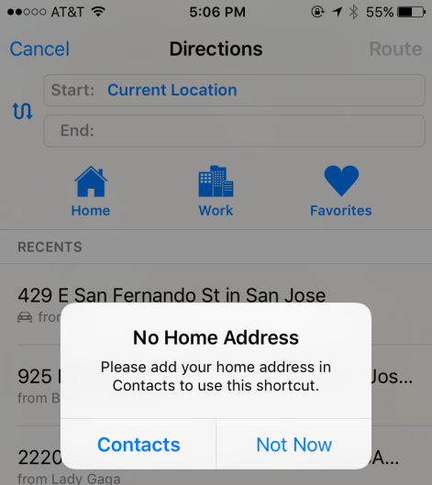
Bad Qualities
3. Voice input
Siri : Out of context of map application
New user may not realize functionality
4. Home/Work address
Can’t add simple text
Goes to Contacts
Does not map conceptual model

Slide 9
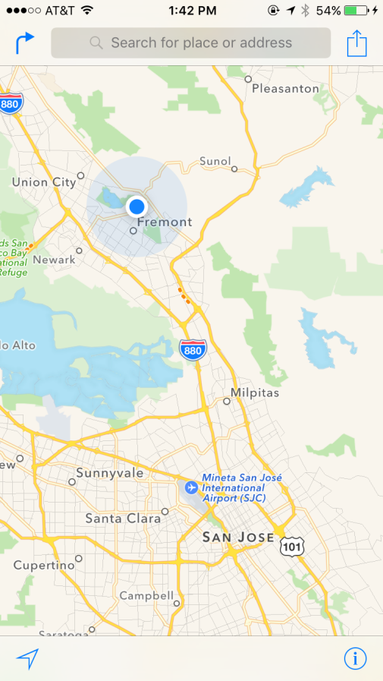
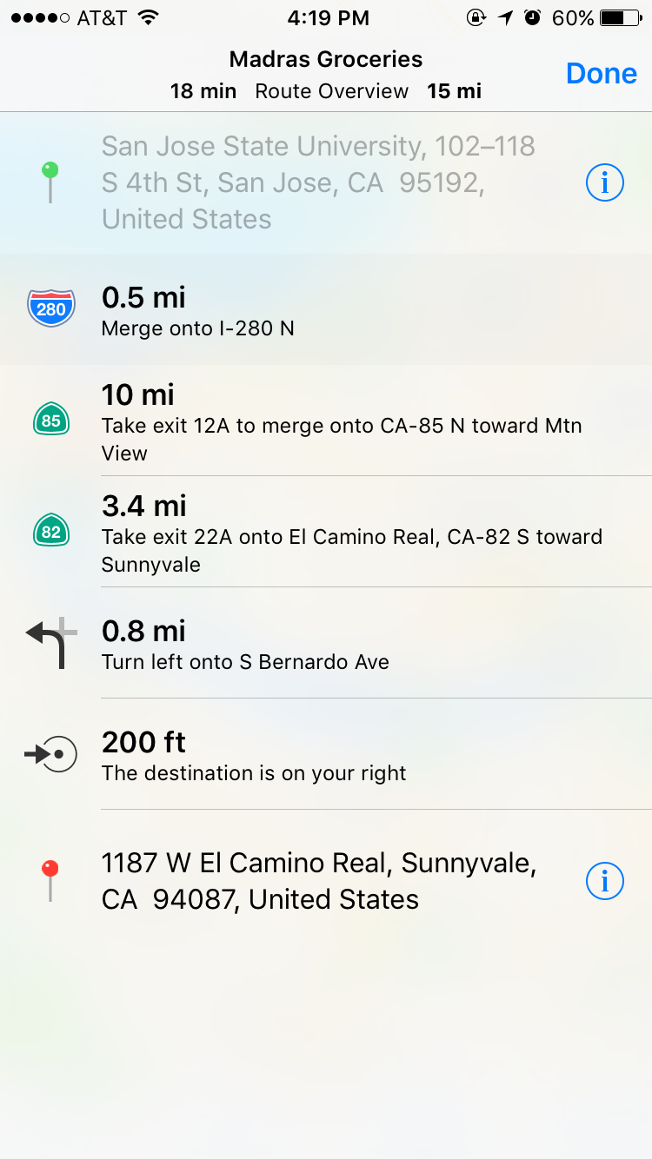
5. Ambiguous Icons
Bad Qualities

Slide 10



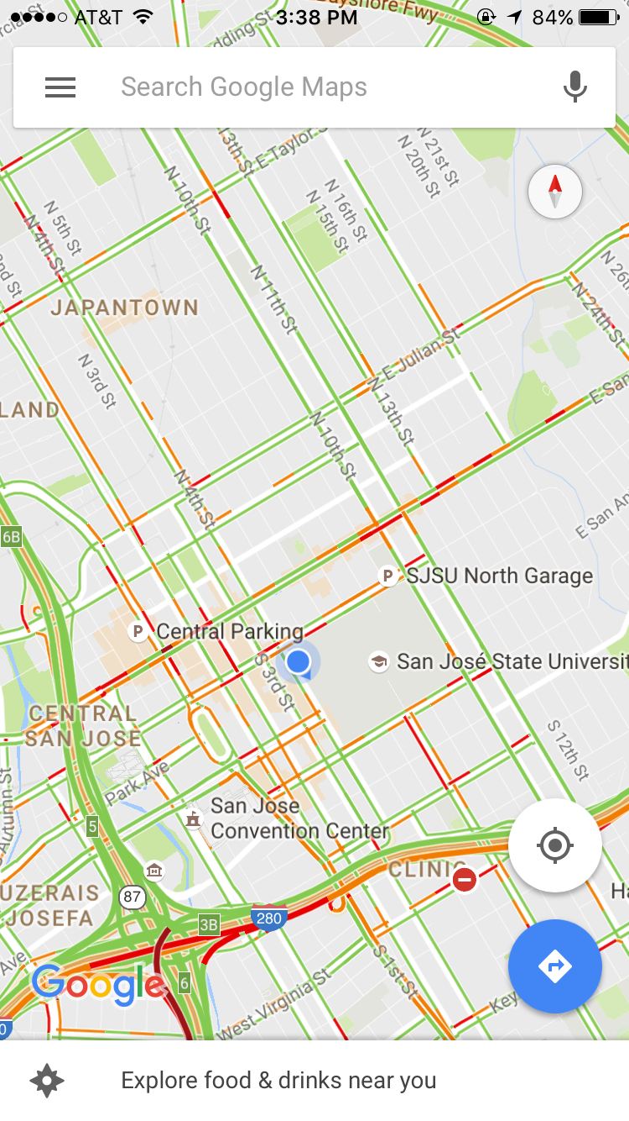
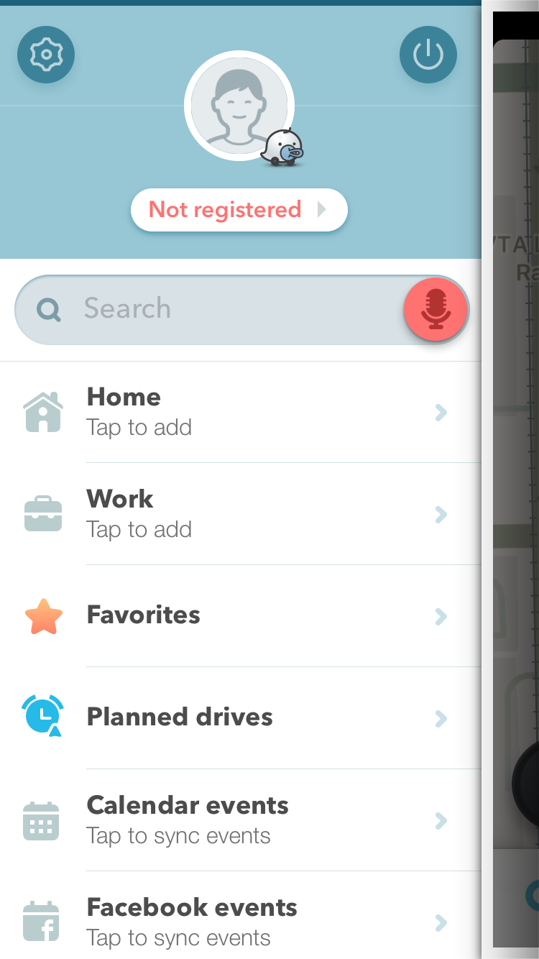

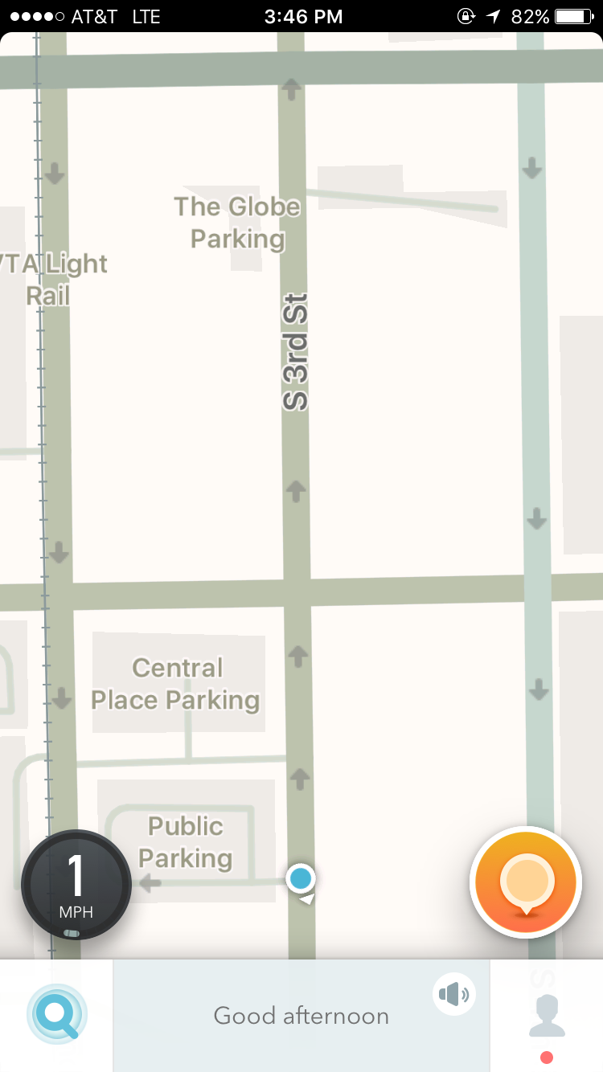
Comparisons
Features | Apple Maps | Google Maps | Waze
Voice Activation | NONE
Easy Access to Orientation

Slide 11
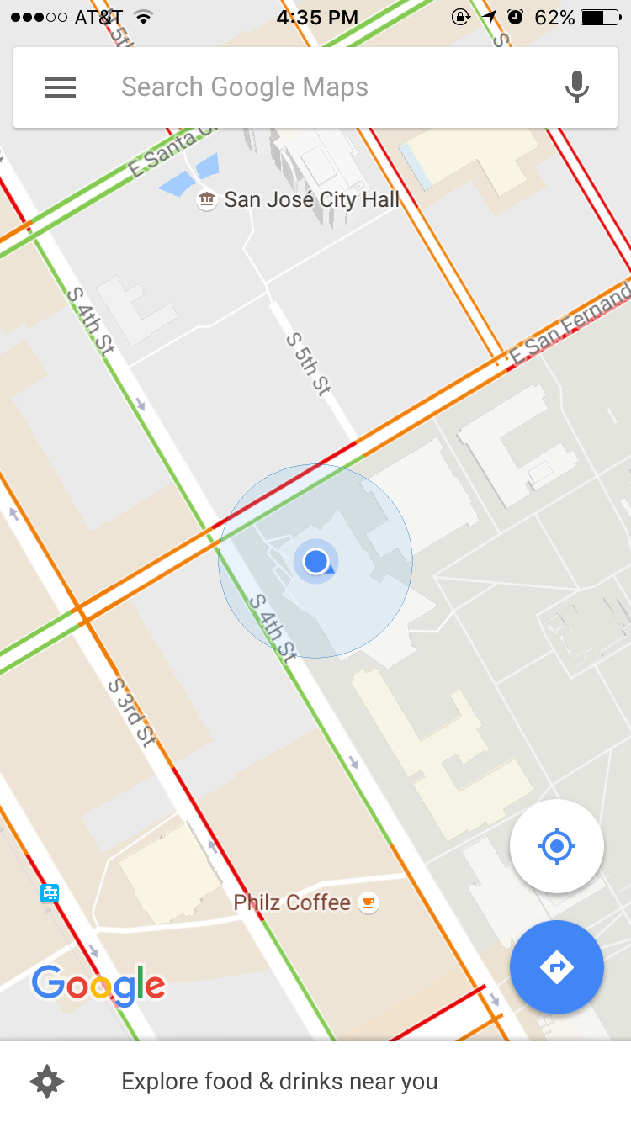
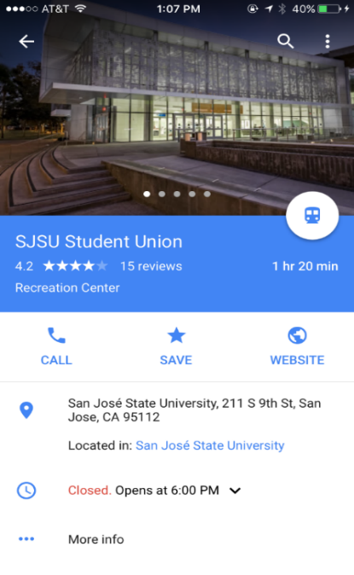
Comparisons
Features | Apple Maps | Google Maps | Waze
Intuitive Menu Icons | NO | YES | NO
Shows Image of destination | NONE |  | NONE

Slide 12

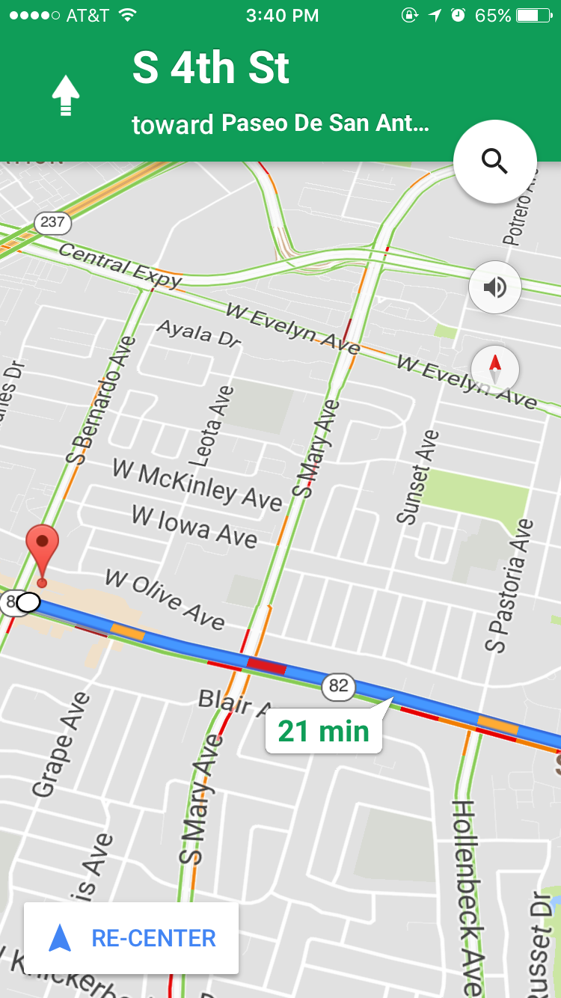
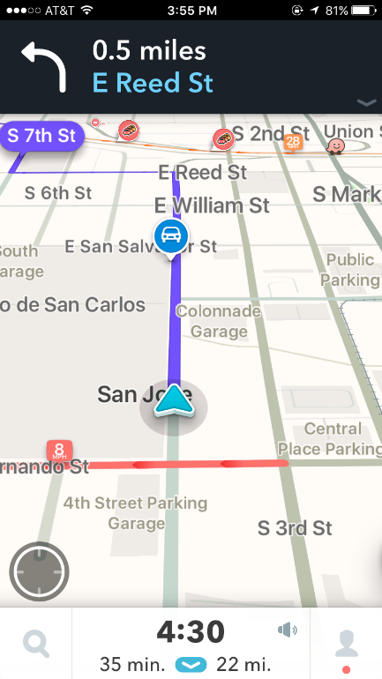
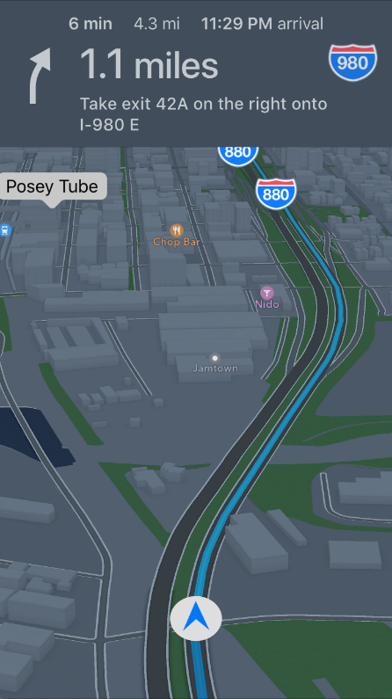
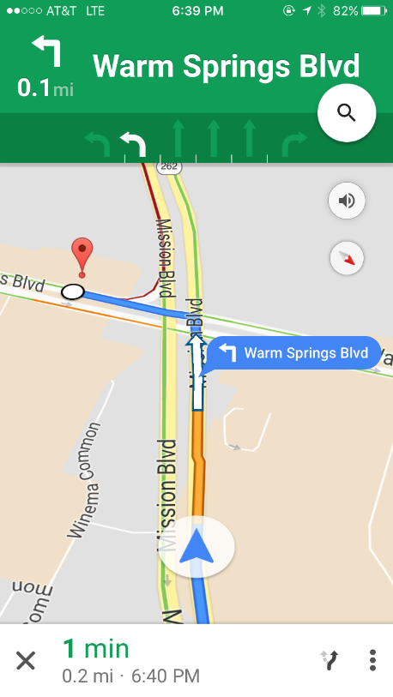
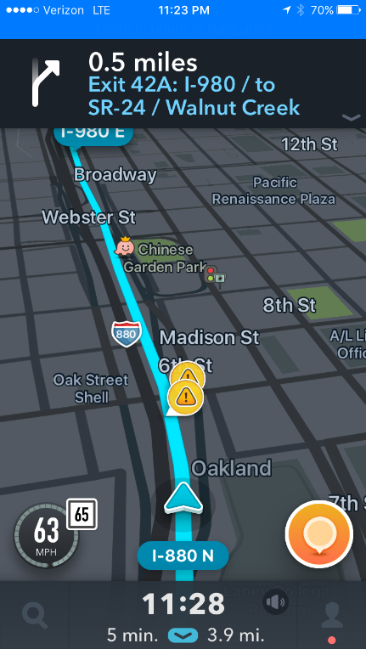
Comparisons
Features | Apple Maps | Google Maps | Waze
Shows Traffic Flow during Navigation
Specified Lane Placement

Slide 13
Concluding Evaluation
How does it measure up for George, Elroy, and Elizabeth?
Suggested Enhancements

Slide 14
Thank You!

